Slide 1


K. J. Somaiya Institute of Engineering and Information Technology
NAAC Accredited Institute with “A” Grade
NBA Accredited 3 Programs (Computer Engineering, Electronics & Telecommunication Engineering & Electronics Engineering)
Permanently Affiliated to University of Mumbai
Employee
Payroll Management System
Under Guidance : Prof. Seema Yadav Mam
Team Members :
Tejas Chaplot [ 05 ]
Adnan Kadiwala [ 22 ]
Jeet Bhanushali [ 03 ]

Slide 2

INTRODUCTION
Employee Payroll Management System is basically used to build an application program, that a company uses to manage the records of employees working in the company.
Only the administration has the legal rights to work with the system. Employees can only log on to the system to see their current status.
It creates, deletes and save records for employees according to their information given to the administration of the company.

Slide 3

OBJECTIVE
Employee Payment information.
Manually data Storing solve.
Admin Access Only.

Slide 4
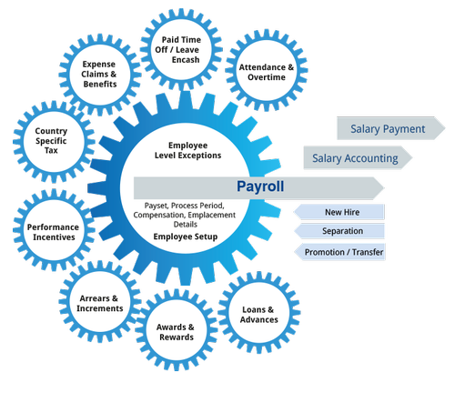
FUNCTIONALITIES
All the information of employees are stored in the company database
All the personal information of the employees are also stored in our system.
our system convert all the information and stored in very less space.
If wrong data is entered in our system then it can also be updated quickly and it can also be deleted.
If Employee want any month or any year salary it can also be generated by our system
storing and accessing the data is also very easy.

Slide 5





IMPLEMENTATION
VISUAL STUDIO
XAMPP
PYTHON 3.9
Tkinter
MySql ,Apache

Slide 6
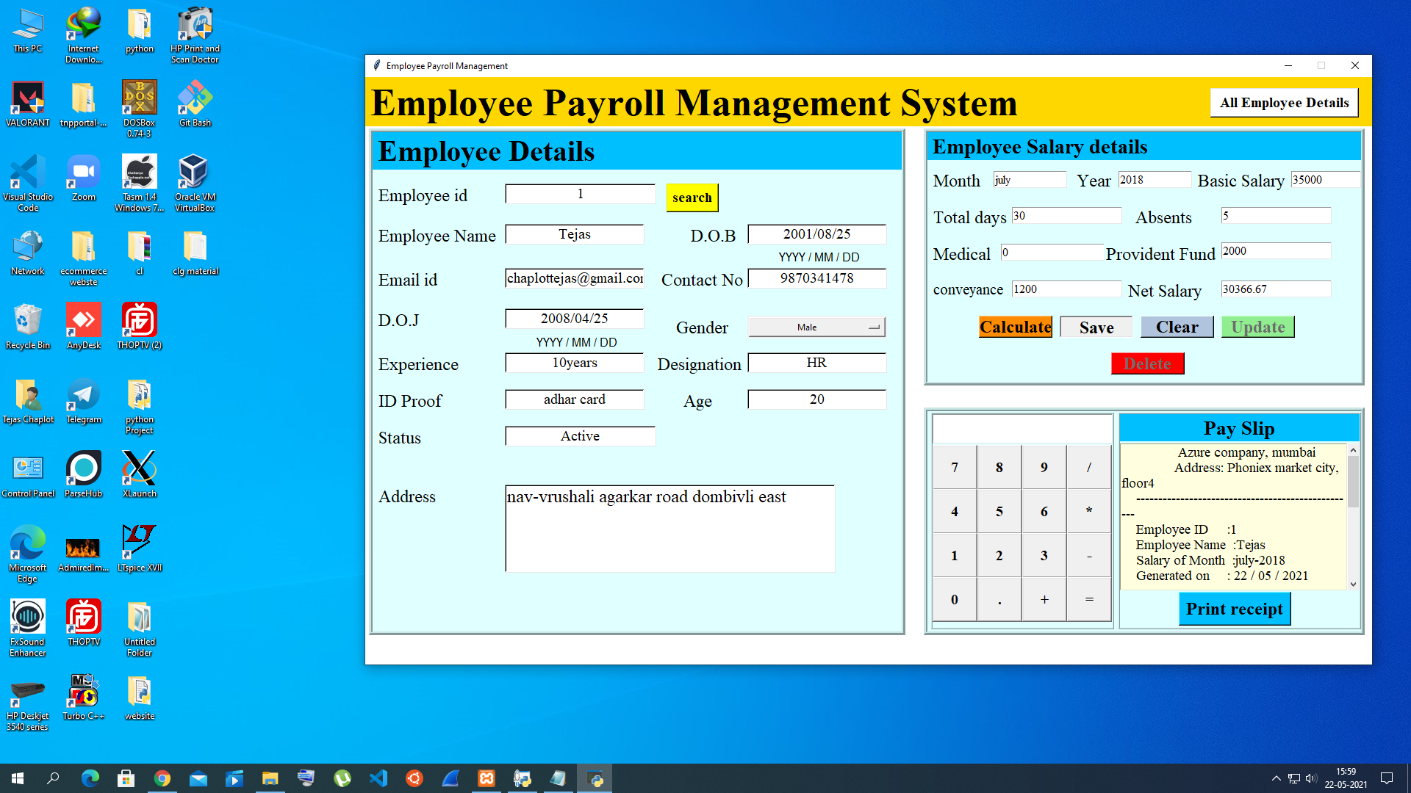
Main Panel
Output Panel

Slide 7
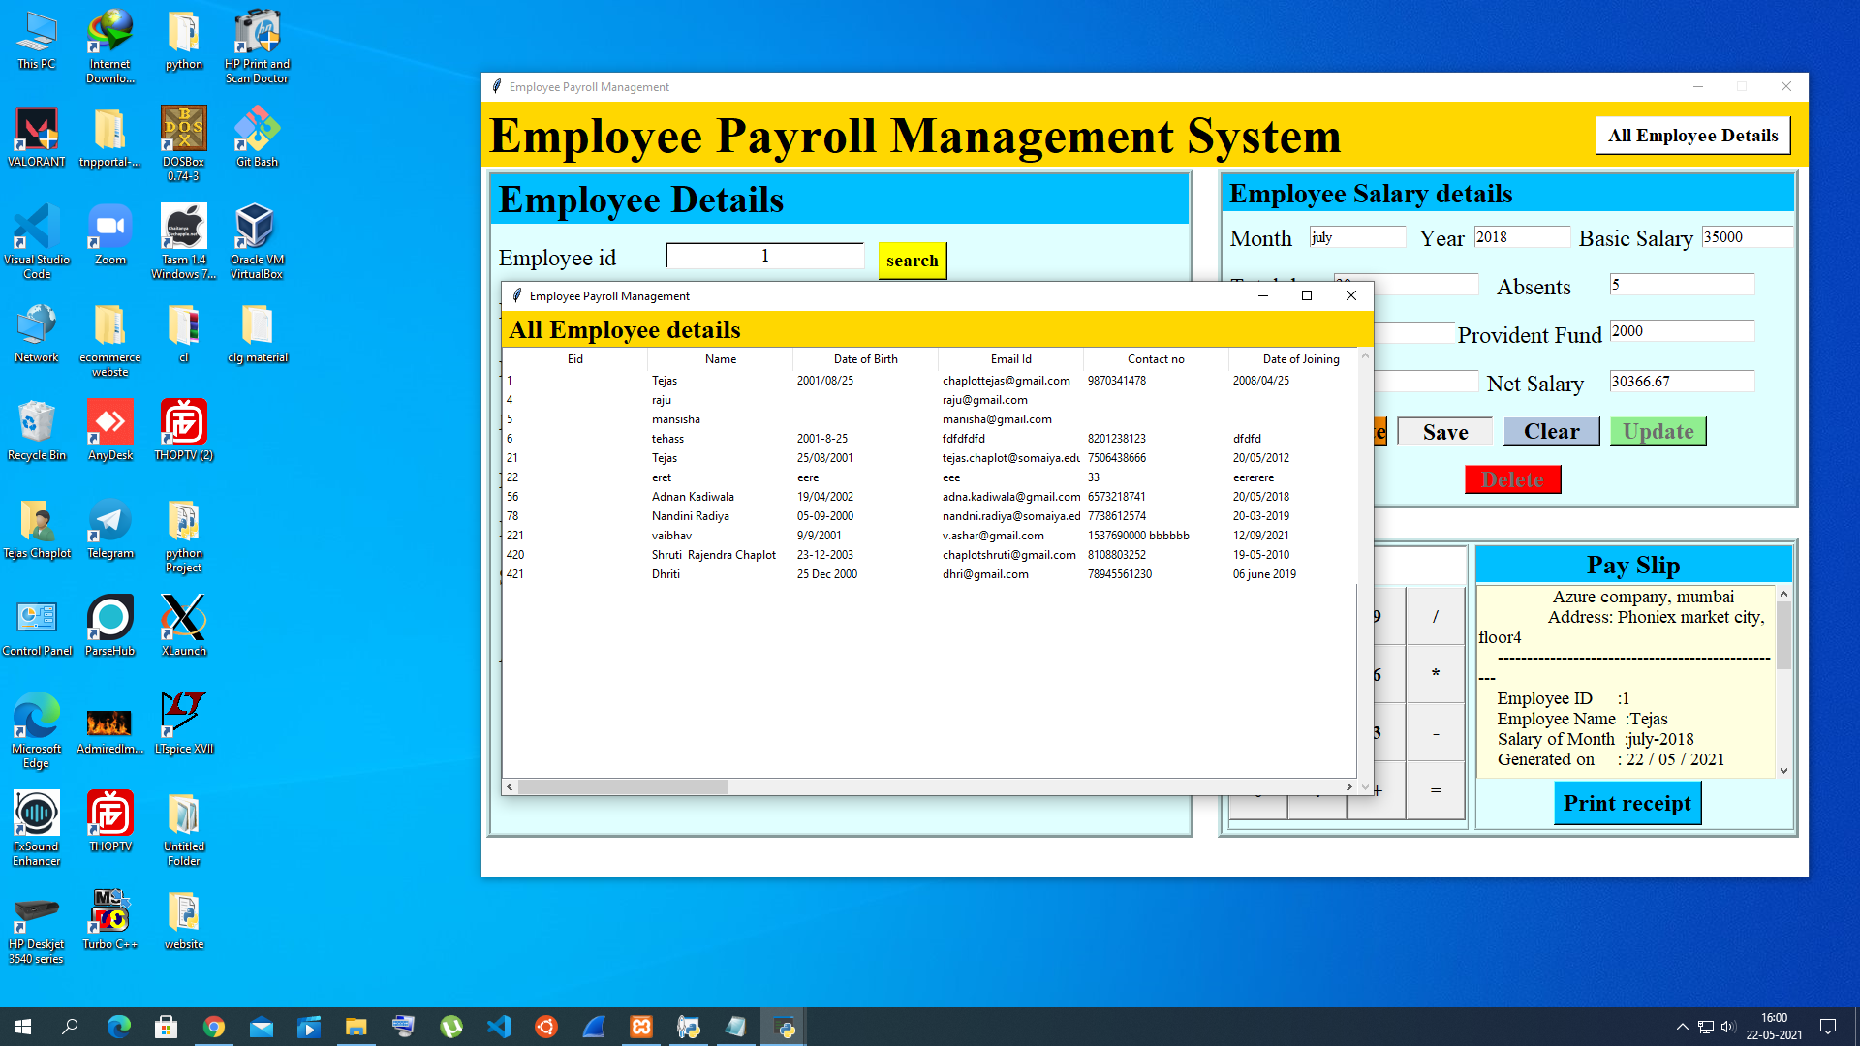
All Employee Details
Details Panel

Slide 8
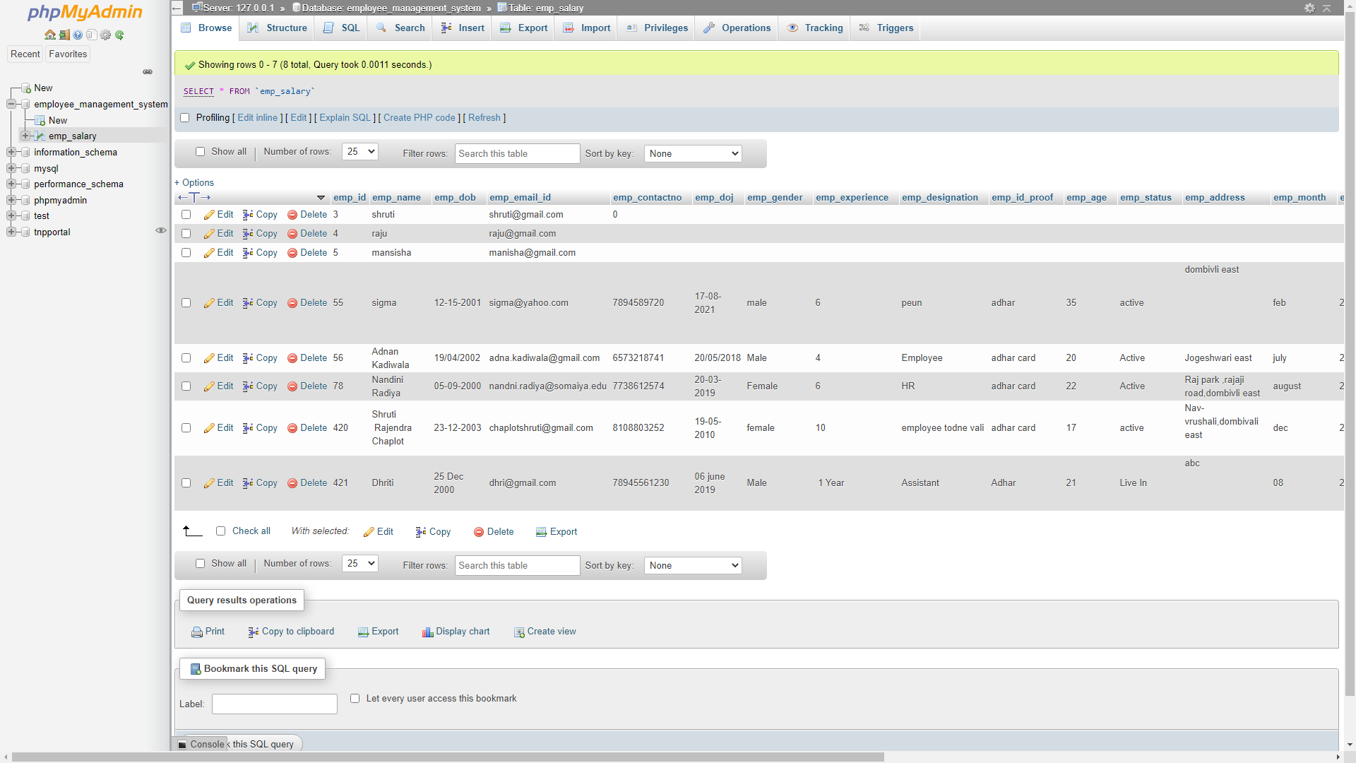
OUR DATABASE
Database

Slide 9

ThankYou

